Slide 1


Social Cognition Chapter 10: Cognitive Processing of Attitude
Rain 2022.4.27

Slide 2
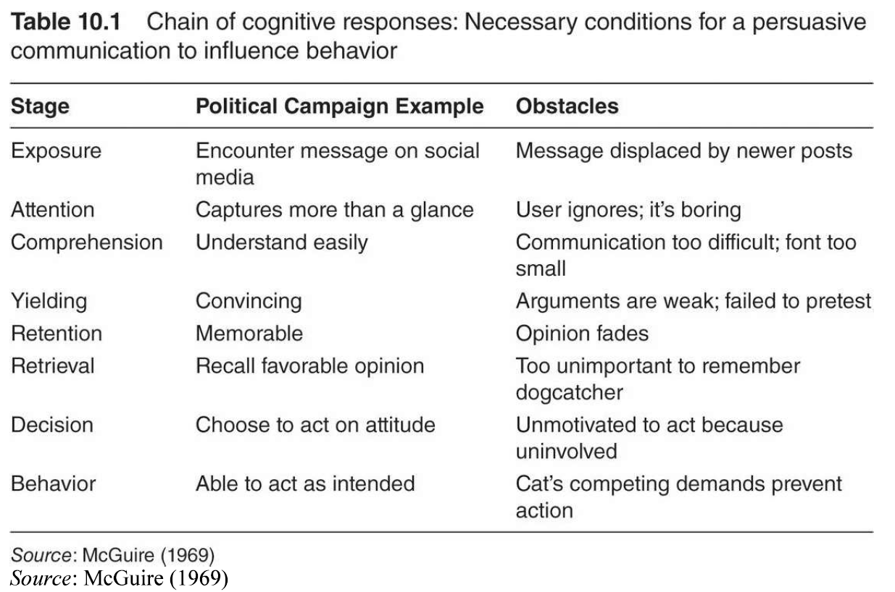
McGuire’s chain of cognitive responses

Slide 3


The main questions:
How we form or change our attitudes?
How does the attitudes activated or retrieved?

Slide 4
Contents
Heuristics versus Systematic Model Anticipates Dual-process approaches
Peripheral versus Central Routes to Persuasion: Elaboration Likelihood Model
Motivation and Opportunity Determine Attitude Process: The MODE model
Implicit Associations Focus on Relatively Automatic Processes
Embodied Attitudes Bypass Cognition?
Neural Correlates of Attitudes Inform Cognitive Approaches

Slide 5
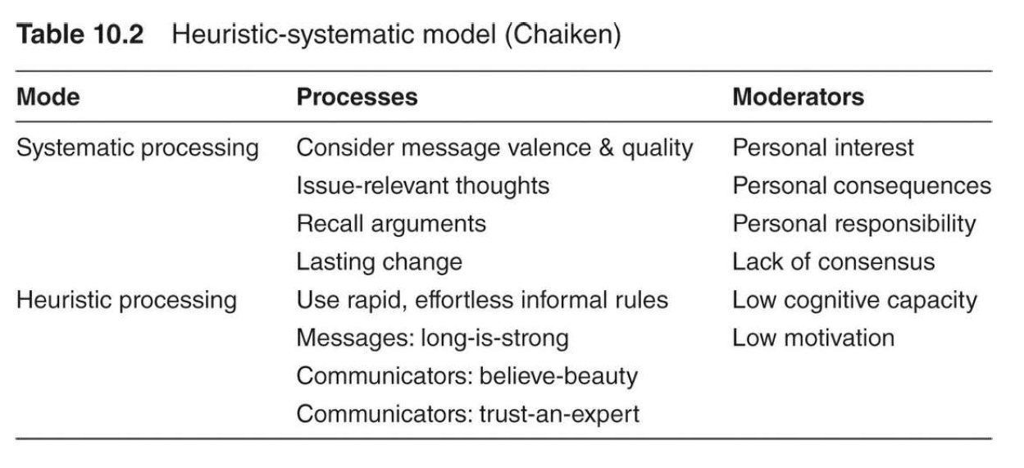
(1) Yale persuasive communication approach: learning message content and conscious acceptance (2) Theory of planned behavior: attitude based on the cognitive beliefs (deliberate process)
1. Heuristics versus Systematic Model Anticipates Dual-process approaches
(3) Heuristic-systematic model

Slide 6
2. Peripheral versus Central Routes to Persuasion: Elaboration Likelihood Model
Elaboration: making relevant associations, scrutinizing the arguments, inferring the value, evaluating the overall message
Central route: active & careful thinking
Peripheral route: without too much thoughts or elaboration
People are motivated to hold correct attitude. The mount and type of cognitive elaboration depend on individual and situational factors

Slide 7
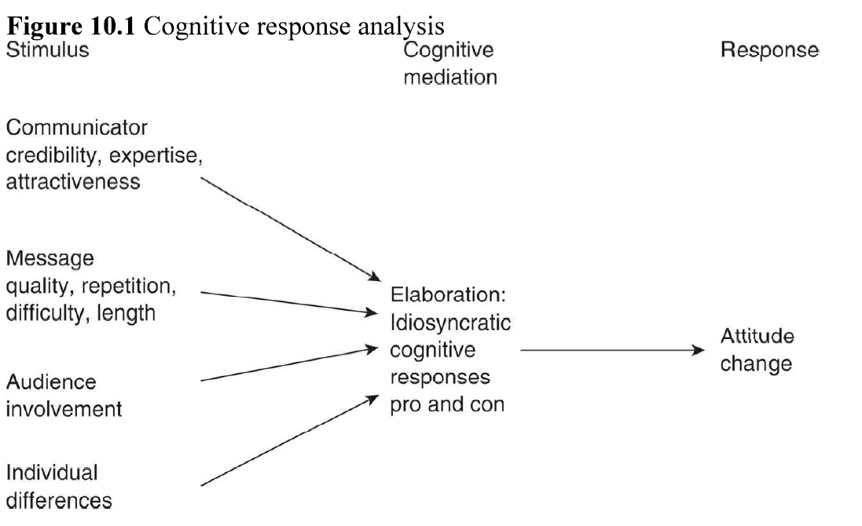
2.1 Methods – Elaboration assessment
Cognitive responses analysis: examine the recipient’s thoughts while receiving the message
Experimental manipulation: Control the quality of information

Slide 8
2.2 Communicator Effects – Who says it
Property of communicator: Expertise & attractiveness & fame
Low outcome involvement: source expertise => peripheral route
Overall, communicator credibility effects typically strongest for recipients not involved in the outcomes

Slide 9
2.3 Message Effects – What is said
(1) Property of message: number of repetitions, difficulty, number of arguments, use of rhetorical questions, number of sources, degree of distraction in context
How these features influence the recipient’s thought?
(2) Mere exposure effects: repeated exposure to nonlinguistic stimuli would increase the favor toward it
(3) Mere exposure effects can be counted into the peripheral route, and under the circumstances of minimal cognitive processing (or even unconscious)
(4) Message repetition effects: cognitive thoughts mediates repetition effects on persuasion, focus on the central route

Slide 10
(5) Two-stage model: uncertainty reduction and tedium counterbalance each other – from agree to disagree
(6) Message difficulty effects modulated by the recipient’s involvement - Comprehension
(7) Effect of number of arguments modulated by personal relevance
Overall, a persuasive message should have good argumants, repeated for a few times bu not too many, comprehensible, and delivered in an atmosphere that no distaction. However, these effects can be modulated by the recipient‘s involvement.

Slide 11
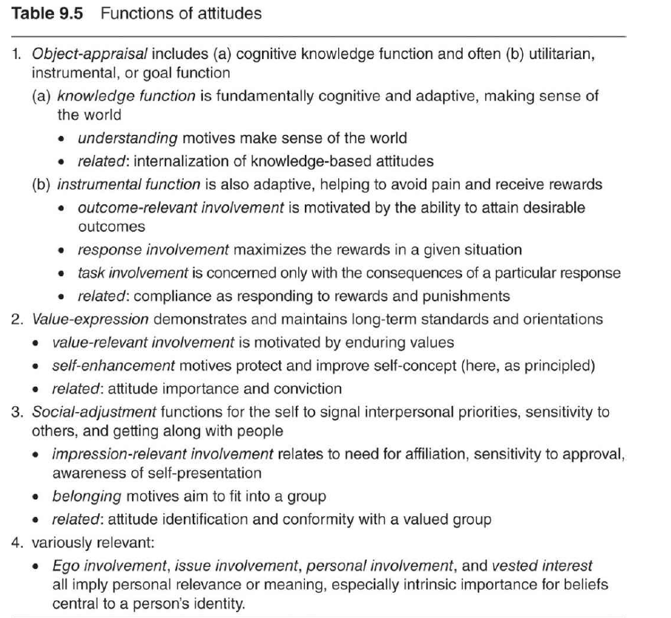
2.4 Audience Involvement
Audience involvement modulates the effect of communicator and message properties
ELM mostly apply to outcome involvement
Outcome involvement influences processing of messages
Outcome-involved people think more, not necessarily accurate or objectively
Types of involvement

Slide 12
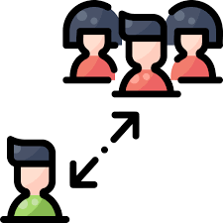
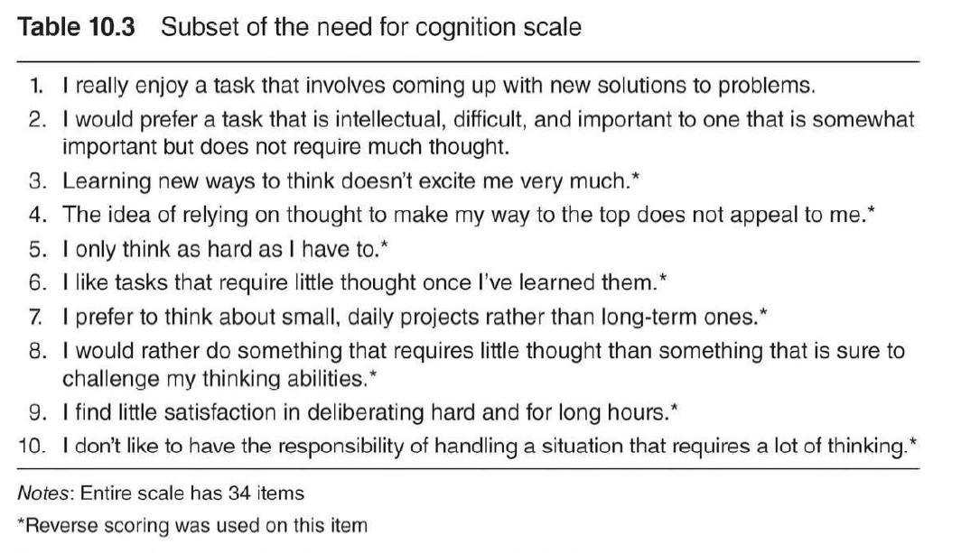
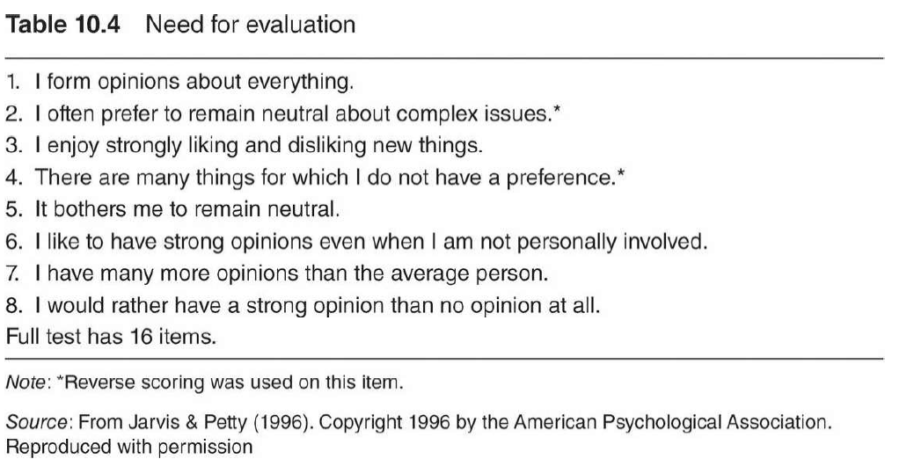
2.5 Individual differences in Cognitive responses and Persuasion
Need for cognition: chronic level of thoughtfulness in response to external stimuli
Uncertainty orientation
Need for evaluation

Slide 13
2.6 Conclusion
The ELM doesn't explain why people agree or disagree
People not only motivated to be accurate, but also need for secure
The multiple role of persuasion variables – Difficulty of prediction

Slide 14
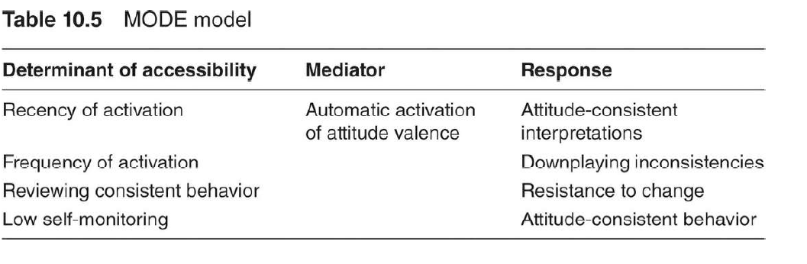
3. Motivation and Opportunity Determine Attitude Process: The MODE model
Automatic activation of attitudes
(1) An association between an object and one’s evaluation
(2) Accessibility of an attitude vital in this process

Slide 15
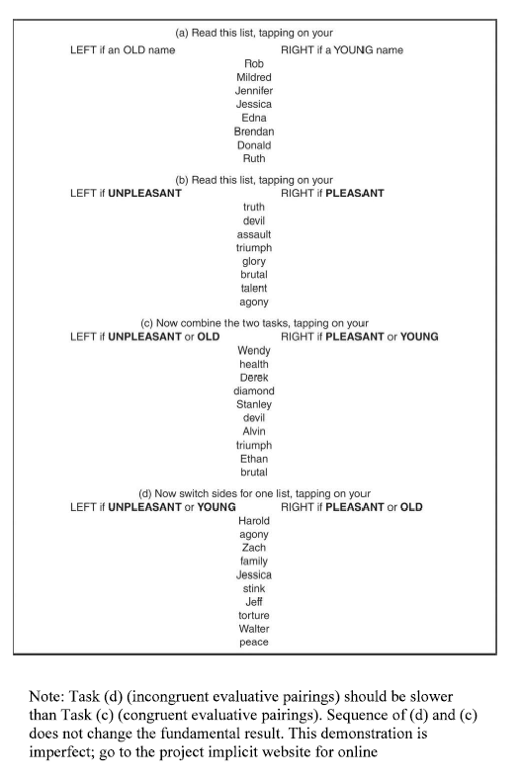
4. Implicit Associations Focus on Relatively Automatic Processes
Implicit association test (IAT)
IAT reveals unconscious prejudice and have excellent predictive validity (stereotyping)
IAT => Covert behavior
Explicit measures => Overt behaviors
Cultural beliefs or Personal attitudes?
Does it really implicit or if it changes with context?

Slide 16
5. Embodied Attitudes Bypass Cognition?
Arm movement: pull ~ positive, push ~ negative
Head nodding: increase of confidence
Facial expressions: simulated emotion

Slide 17
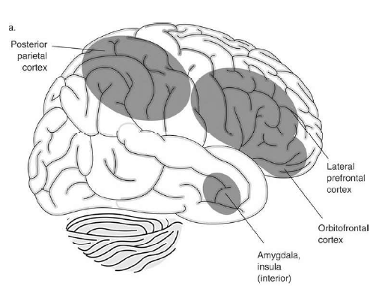
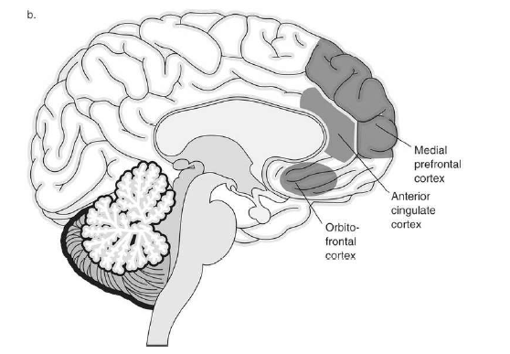
6. Neural Correlates of Attitudes Inform Cognitive Approaches

Slide 18
Summary
Heuristics – Systematic model
Elaboration likelihood model
Motivation and Opportunity Determine Attitude Process
Implicit association test

Slide 19
Thanks for listening!

